Slide 1
Use case Analysis

Slide 2
Use-Cases: describing how the user will use the system
A use case is a typical sequence of actions that a user performs in order to complete a given task
The objective of use case analysis is to model the system from the point of view of
… how users interact with this system
… when trying to achieve their objectives.
It is one of the key activities in requirements analysis
First step in use case analysis is to determine the types of users or other systems that will use the facilities of this system. These are called actors.
A use case model consists of
a set of use cases
an optional description or diagram indicating how they are related

Slide 3
Use cases
The second step in use case analysis is to determine the tasks that each actor will need to do with the system.
Each task is a use case
A use case should
Cover the full sequence of steps from the beginning of a task until the end.
Describe the user’s interaction with the system ...
Not the computations the system performs.
Be written so as to be as independent as possible from any particular user interface design.
Only include actions in which the actor interacts with the computer.
Not actions a user does manually

Slide 4
Use case Example
List a minimal set of use cases for the following actors in a library system:
Borrower, Checkout Clerk, Librarian
Borrower:
❏ Search for items by title.
❏ … by author.
❏ … by subject.
❏ Check the borrower’s personal information and list of books currently borrowed.
Checkout Clerk:
❏ All the Borrower use cases, plus
❏ Check out an item for a borrower.
❏ Check in an item that has been returned.

Slide 5
Use case Example….
❏ Renew an item.
❏ Record that a fine has been paid.
❏ Add a new borrower.
❏ Update a borrower’s personal information (address, telephone number etc.).
Librarian:
❏ All of the Borrower and Checkout Clerk use cases, plus
❏ Add a new item to the collection.
❏ Delete an item from the collection.
❏ Change the information the system has recorded about an item.

Slide 6
How to describe a single use case
A. Name: Give a short, descriptive name to the use case.
B. Actors: List the actors who can perform this use case.
C. Goals: Explain what the actor or actors are trying to achieve.
D. Preconditions: State of the system before the use case.
E. Summary: Give a short informal description.
F. Related use cases.
G. Steps: Describe each step using a 2-column format. The left column showing the actions taken by the actor, and the right column showing the system’s responses.
H. Post conditions: State of the system in following completion.
A and G are the most important

Slide 7
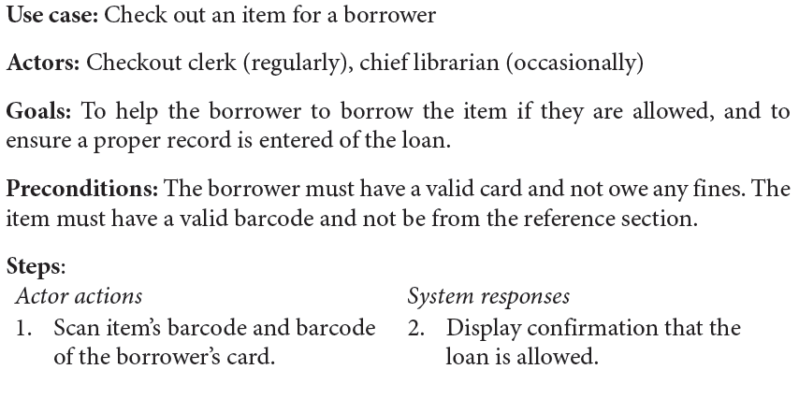
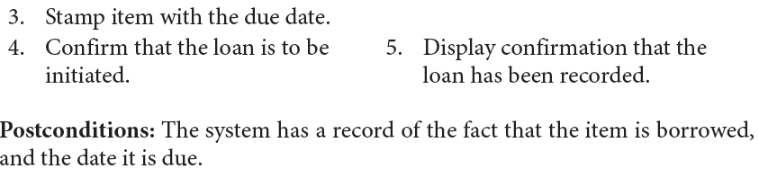
Use Case Description: Example

Slide 8
Use case diagrams
Use case diagrams are UML’s notation for showing the relationships among a set of use cases and actors.
They help a software engineer to convey a high-level picture of the functionality of a system.
there are two main symbols in use case diagrams:
An actor is shown as a stick person
a use case is shown as an ellipse.
Lines indicate which actors perform which use cases.

Slide 9
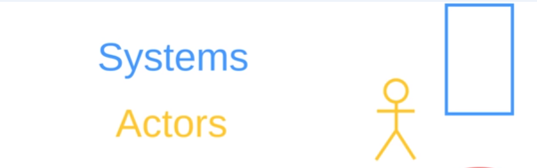
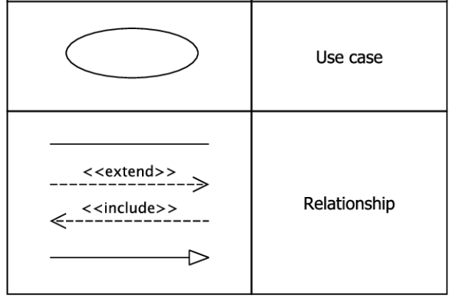
Use case diagrams .....
Symbols used in Use case Diagram

Slide 10
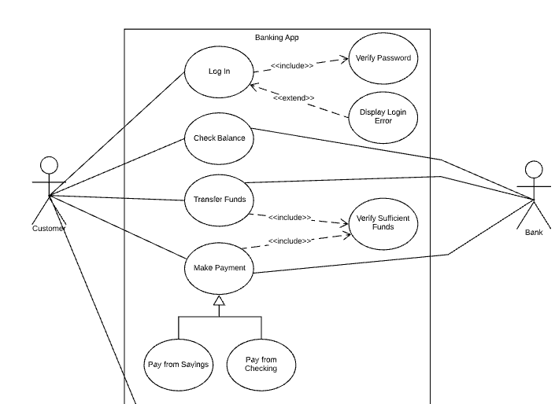
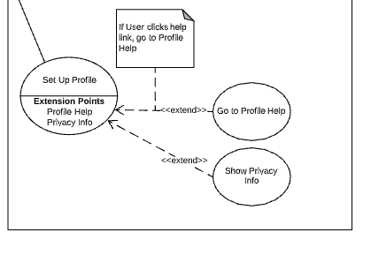

Slide 11
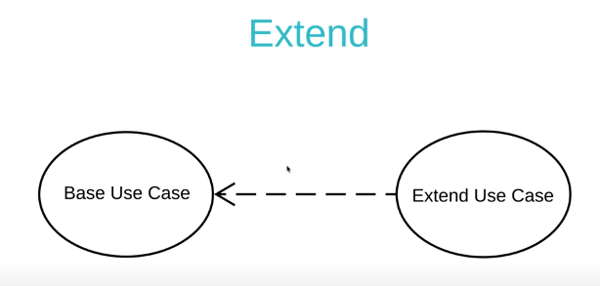
Use case diagrams….
Extensions
Used to make optional interactions explicit or to handle exceptional cases.
Keep the description of the basic use case simple.

Slide 12
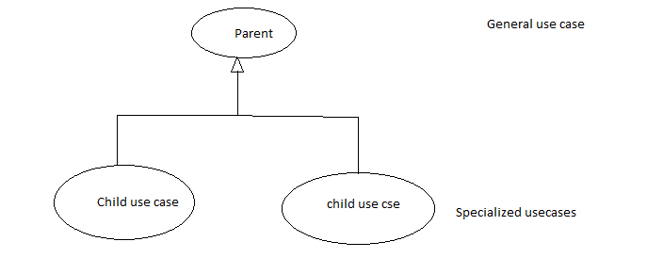
Use case diagrams….
Generalizations
Also called inheritance
A generalized use case represents several similar use cases.
One or more specializations provides details of the similar use cases.

Slide 13
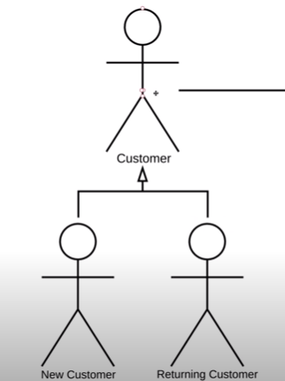
Use case diagrams….
Generalization of actors

Slide 14
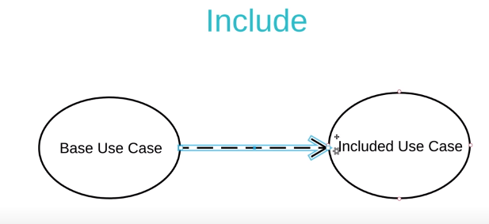
Use case diagrams….
Inclusions
Show the relationship between base use case and included use case.
Every time the base use case is executed ,the included use case is executed well.
Allow one to express commonality between several different use cases.
Are included in other use cases
Even very different use cases can share sequence of actions.
Enable you to avoid repeating details in multiple use cases.

Slide 15
The benefits of basing software development on use cases
They can
Help to define the scope of the system
Be used to plan the development process
Be used to both develop and validate the requirements
Form the basis for the definition of test cases
Be used to structure user manuals

Slide 16
Use cases must not be seen as a panacea
The use cases themselves must be validated
Using the requirements validation methods.
Some aspects of software are not covered by use case analysis.
Innovative solutions may not be considered.

